Slide 1
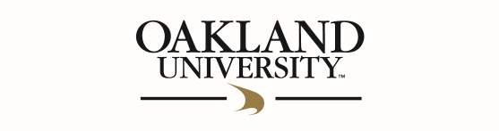
Stock Predictor
Chenson Johnson, Binju Shrestha, Samuel Khalil, David Osterhoff, Yunfan Yang, Zheng Zeng, Zhuoming Lei

Slide 2
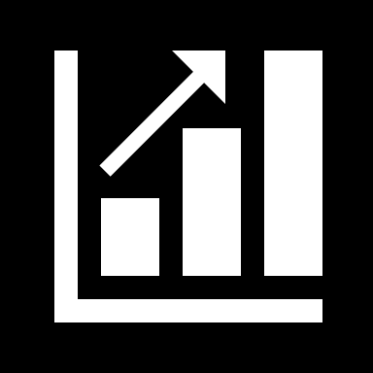
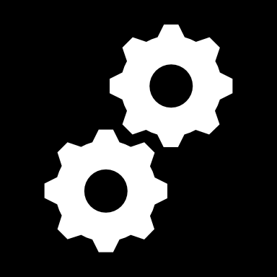
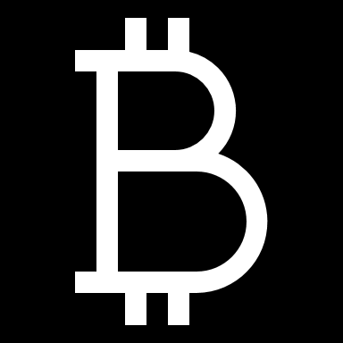
Overview
Stock market is becoming more and more unpredictable due to large number of predictive and computerized trading.
Our goal through this project is to build unified model using known strategies (i.e. technical analysis) and provide guidance about investments.
The system shall also display various measures and historical return of the given stock based on various buy and sell points.

Slide 3
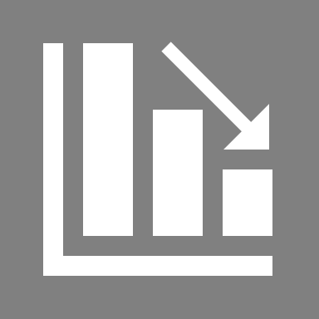
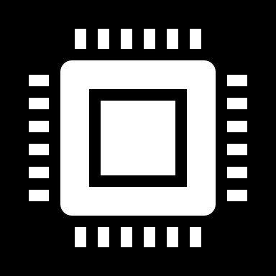
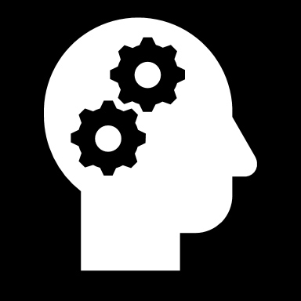
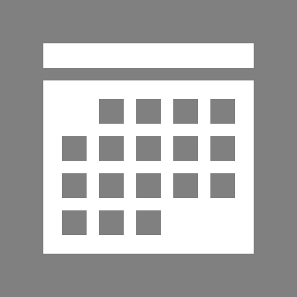
Risk & Challenges
Lack of experience and unfamiliar with how the stock market works
We need to refresh ourselves with some programming languages such as Python
We also need to learn how to use machine languages to predict the stock market since we don’t have any experience with machine learning techniques
Time frame for this project is low and everyone’s schedule does not align perfectly so there may be some scheduling problems

Slide 4
Mitigation Plan
Preparation
Set aside
Discussions
Support
Every group member must be prepared to put in 40 to 60 hours the first week in order to refresh themselves on Python.
Set aside at least 10 hours to watch YouTube videos on how the stock market works and to look for examples of predictive software already in the marketplace.
Have group discussions the first week and make a concrete time to meet via in person or by Skype.
Group members support and help each other in the areas that they are lacking.

Slide 5
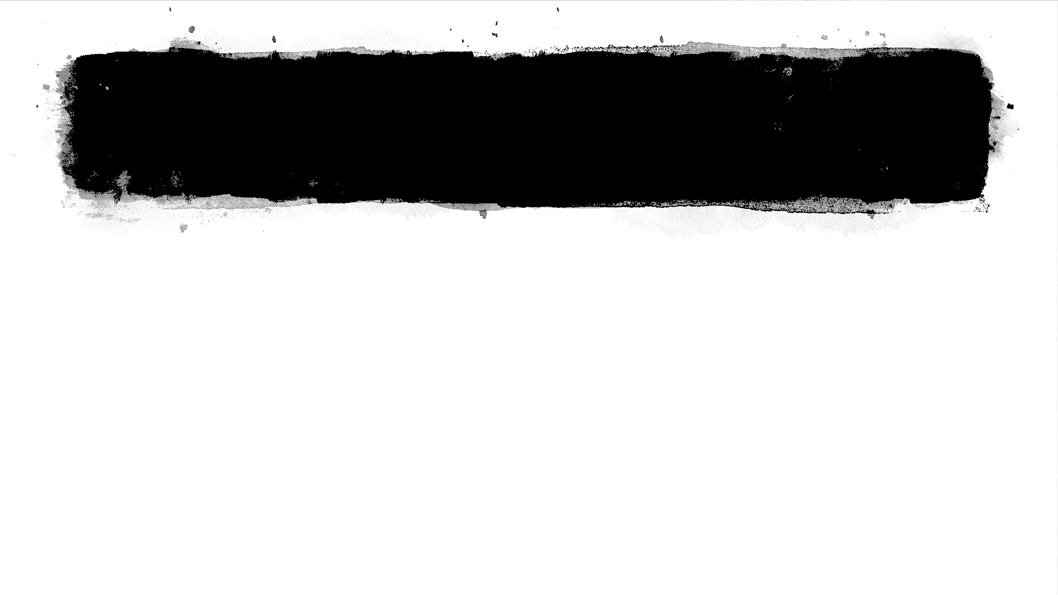
Project Requirements
1
2
3
4
System must have a user-friendly interface with login capabilities
The system must be able to access current as well as historical data
The system must be able to output data in a graphical format
System must have a unified model for providing guidance about investment returns

Slide 6
Project Plan
Develop software that predicts the price of the stock market in the next 2 weeks through the help of historical data and algorithm calculations
The software provides guidance to the users in the stock market business in order to help the users with their investment
We will implement the problem using machine learning techniques

Slide 7
Program Tools
Programming Language - Python
Flask Framework
Programming Tool - Visual Studio
Configuration Manager - Github, Google Drive
Server - Azure or AWS

Slide 8
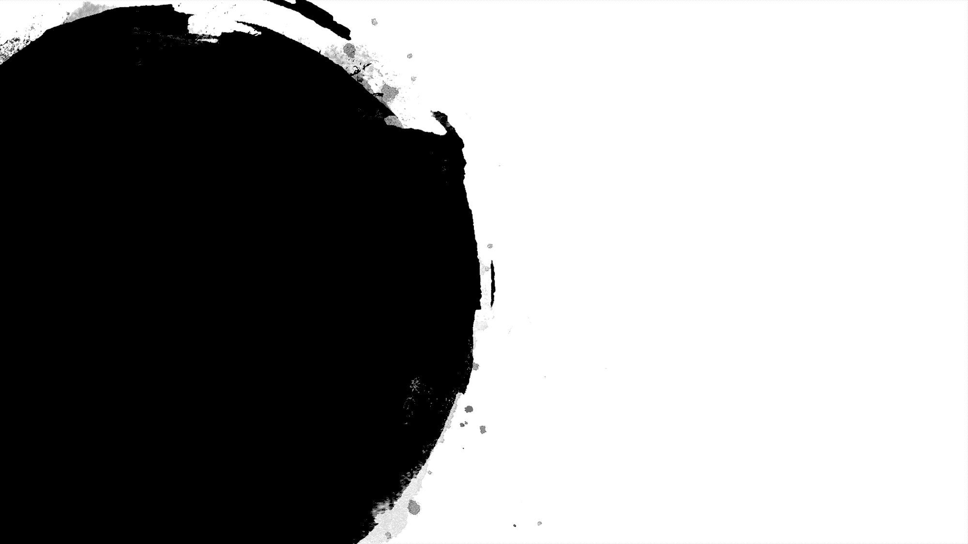
Questions?

